Slide 1
Stress!
Transcription factors change a cell’s genetic program
Response

Slide 2
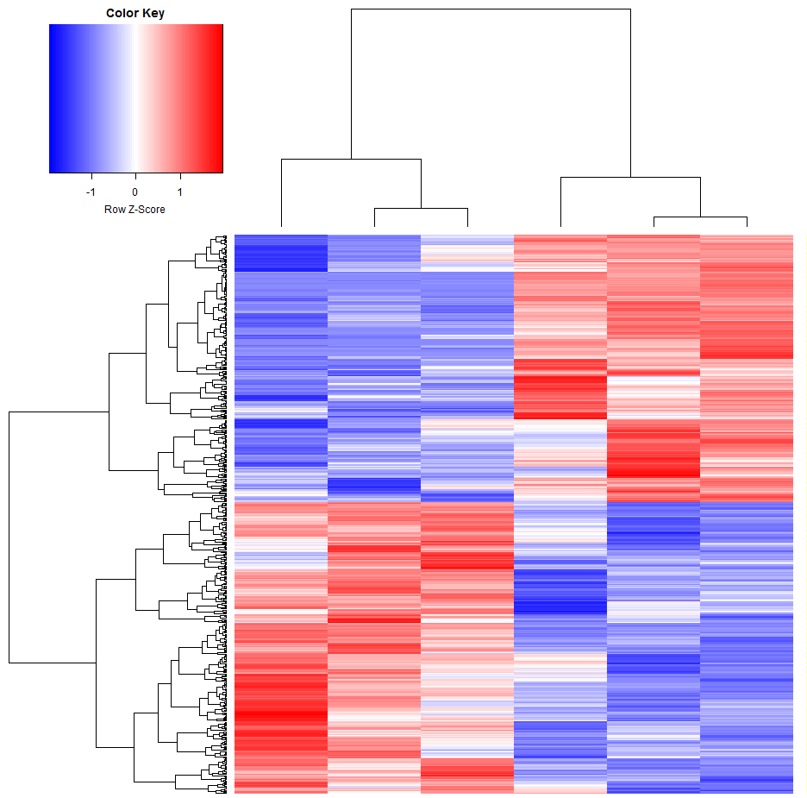
Transcription factors can alter global gene expression

Slide 3
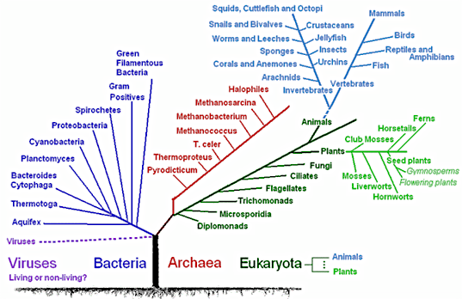
The tree of life
Why Archaea?
diversity
extremophiles
medical applications
our close cousins
our microbiota

Slide 4
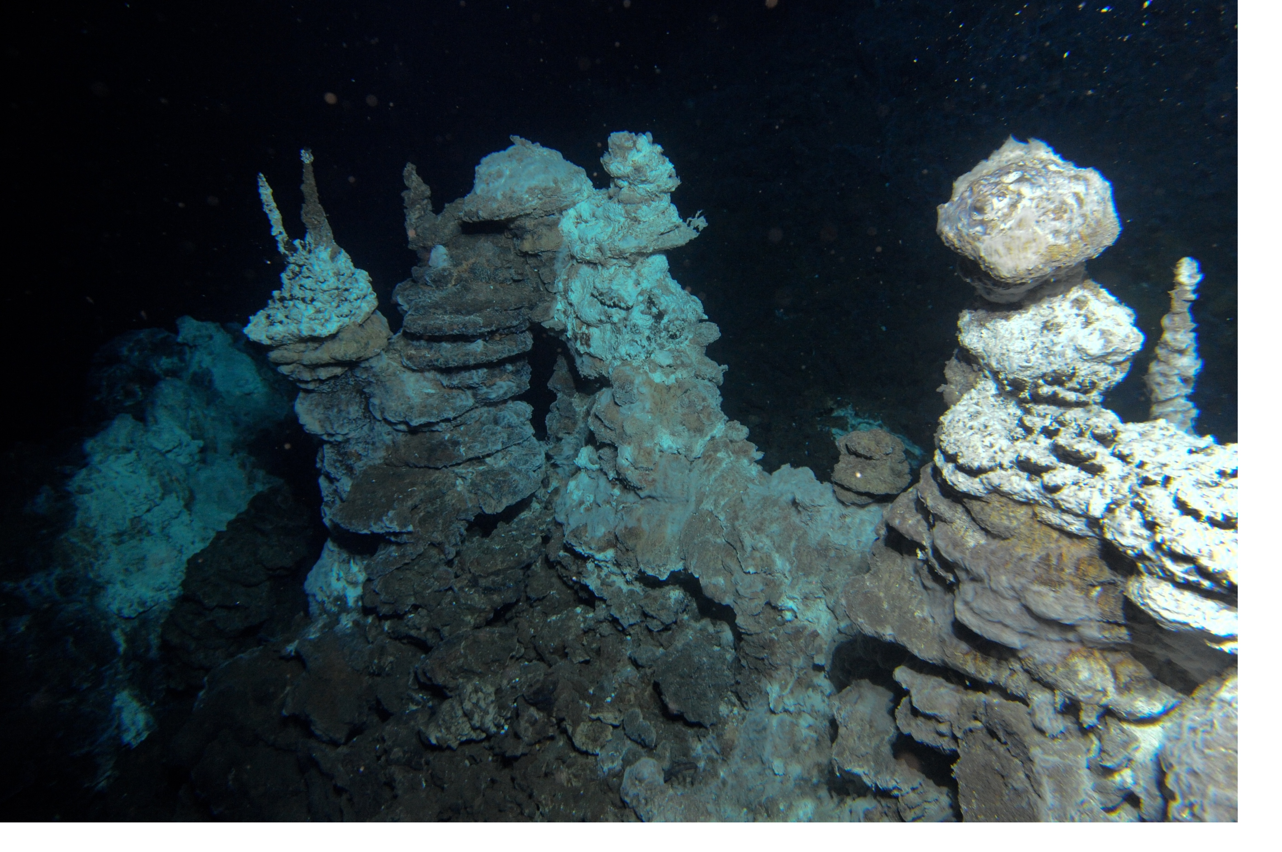
Archaea: the Asgards

Slide 5
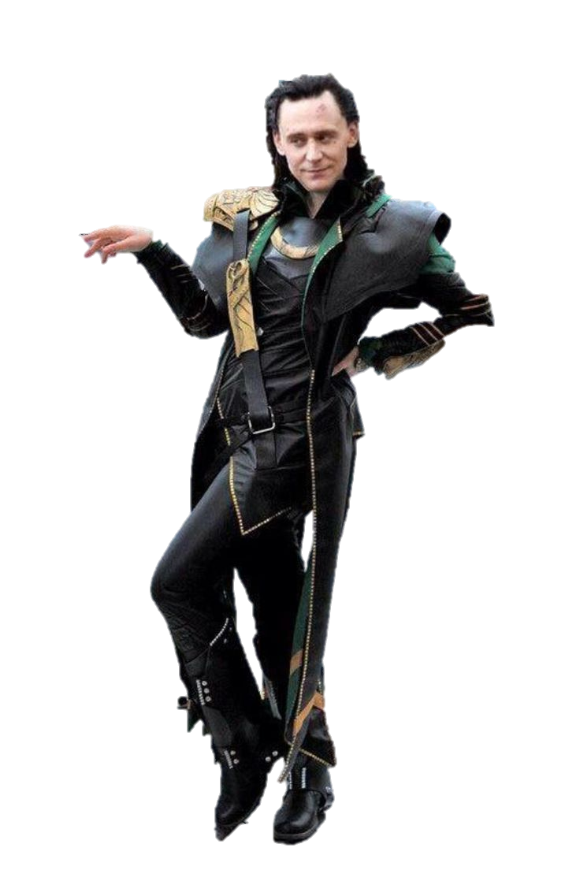
Archaea: the Asgards

Slide 6



Archaea: the Asgards

Slide 7
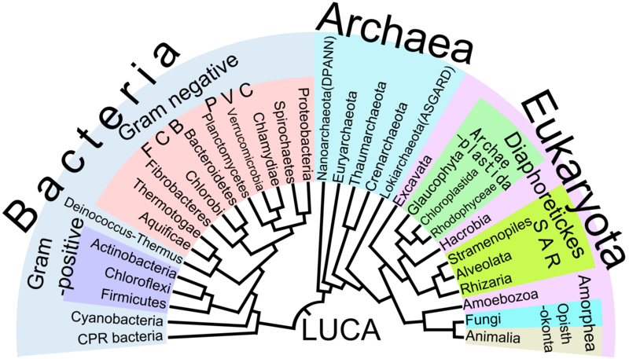
The tree of life

Slide 8
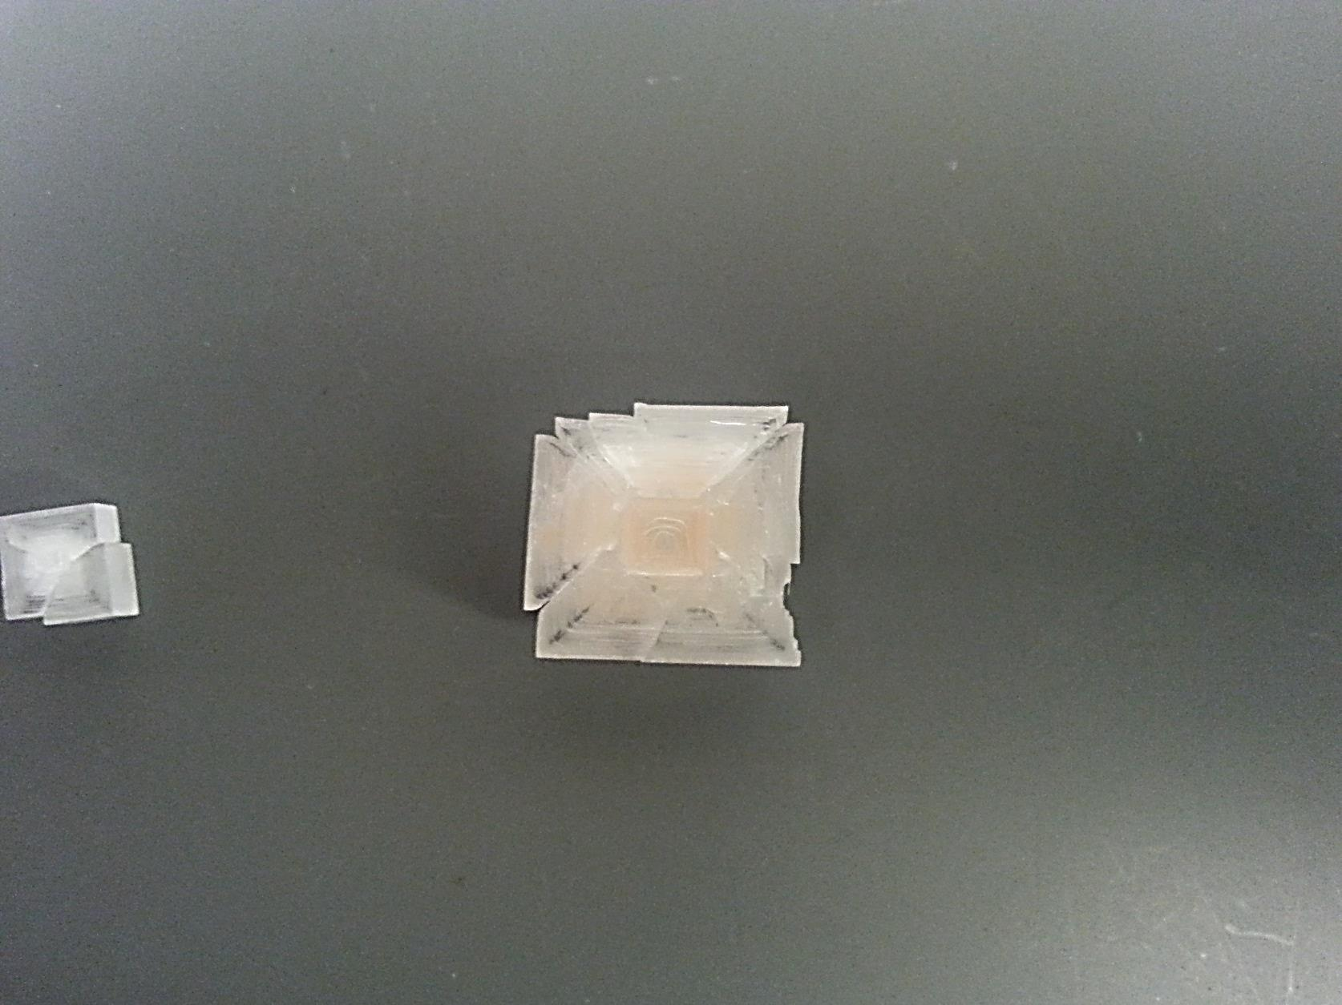
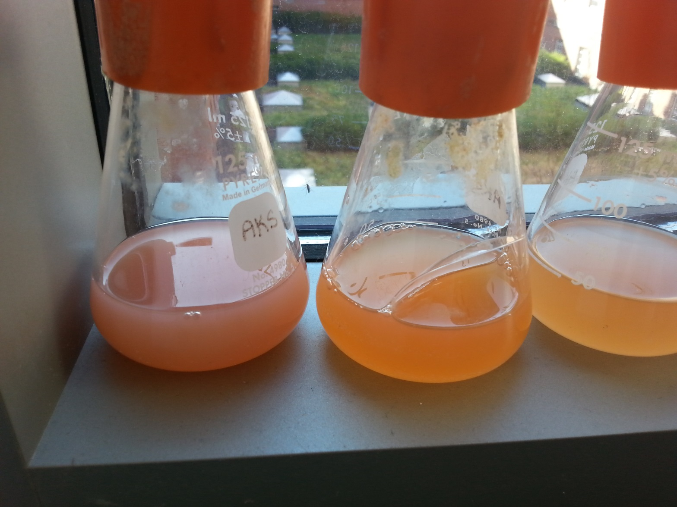
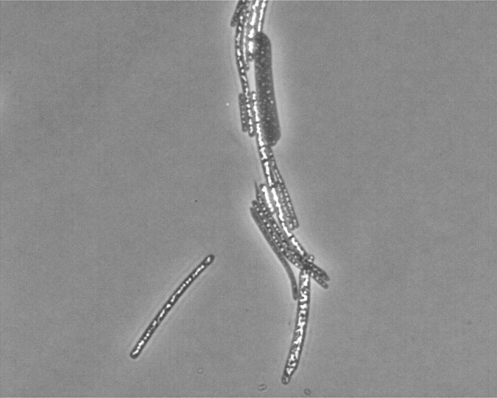
Fun facts about Halobacterium salinarum
Prefers 4.2 M NaCl, 42°C for optimal growth
Survives UV-C at 254nm (lethal to E. coli)
Survives space-like vacuum (1 millitorr)

Slide 9
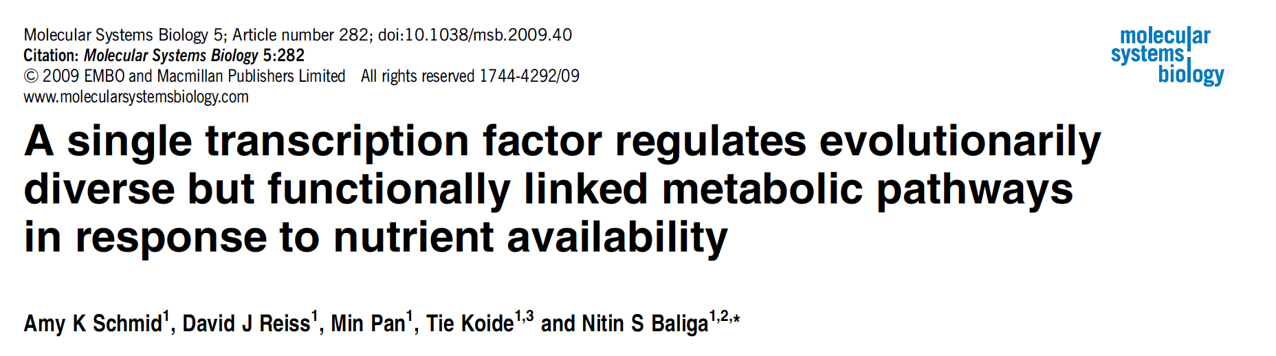

Slide 10
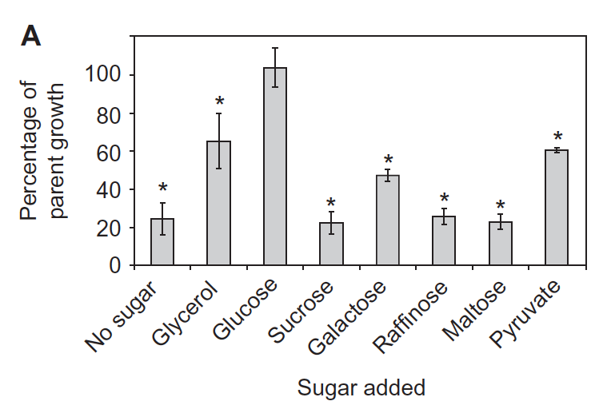
ΔtrmB can only grow when glucose* is around
OD600
Time (h)

Slide 11
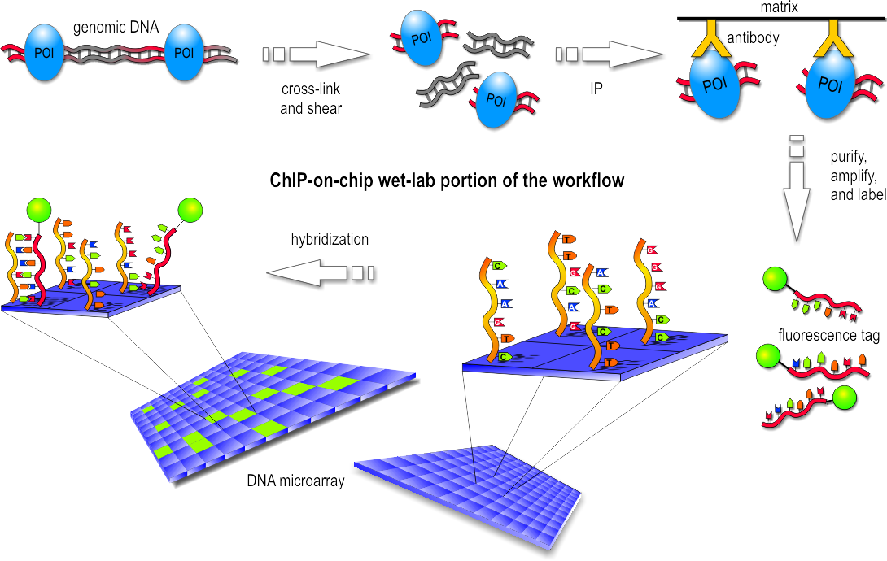
ChIP-chip
Chromatin ImmunoPrecipitation on DNA microarray chip

Slide 12
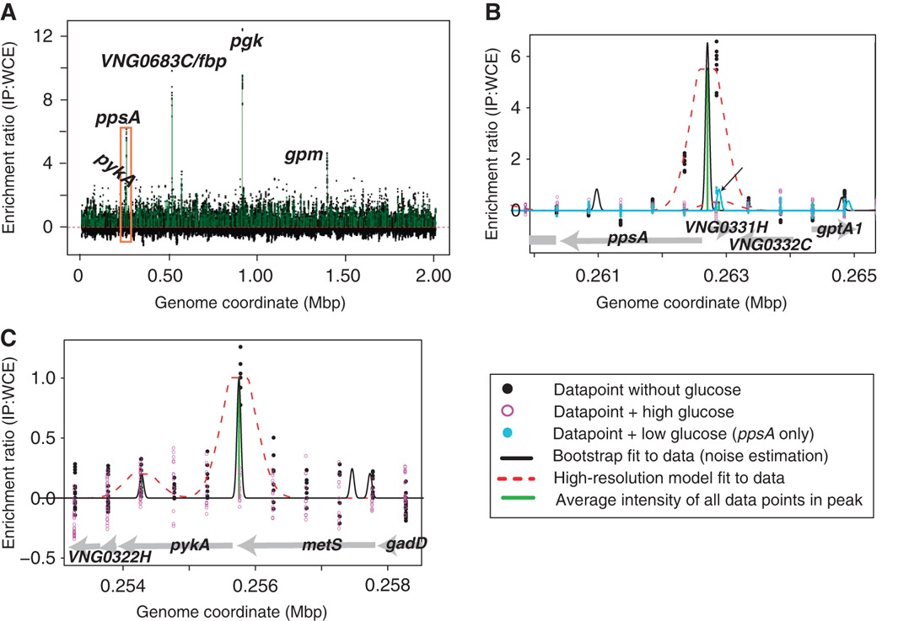
ChIP-chip reveals TrmB binds to promoters of metabolic genes

Slide 13
Gene Expression by microarray
Harvest RNA
convert to cDNA

Slide 14
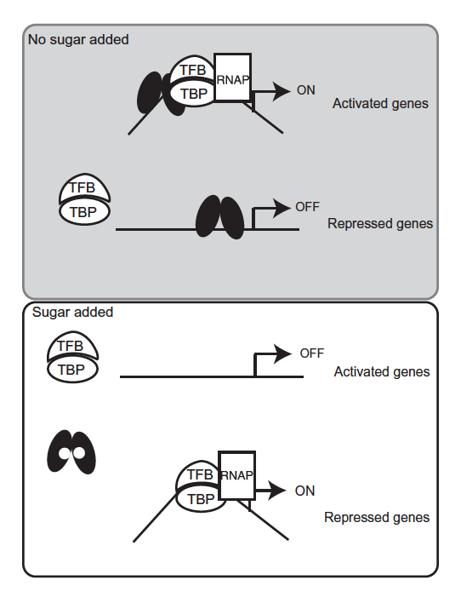
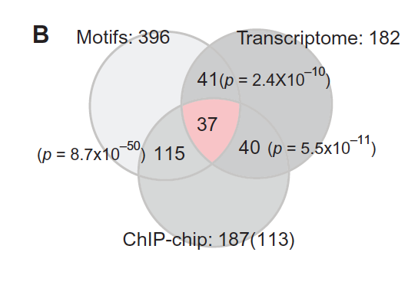
Combining gene expression, ChIP, and binding motif information comparing with and without glucose, Amy et al devised a model for TrmB function

Slide 15
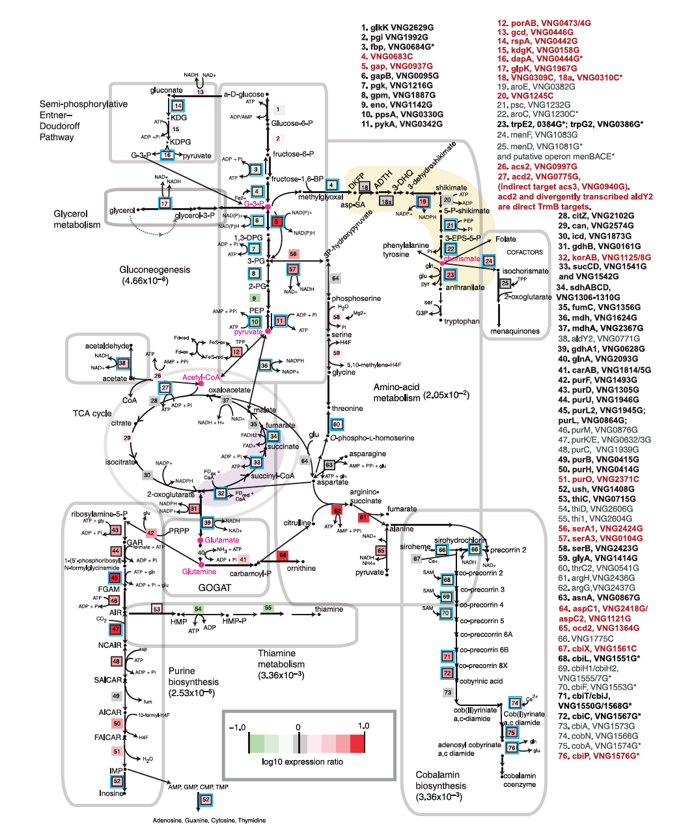
TrmB turns on gluconeogenic genes when there is no glucose around
Gluconeogenic
genes
Glycolytic
genes

Slide 16
TrmB turns on gluconeogenic genes when there is no glucose around
but why?
Halobacterium salinarum doesn’t metabolize glucose!

Slide 17
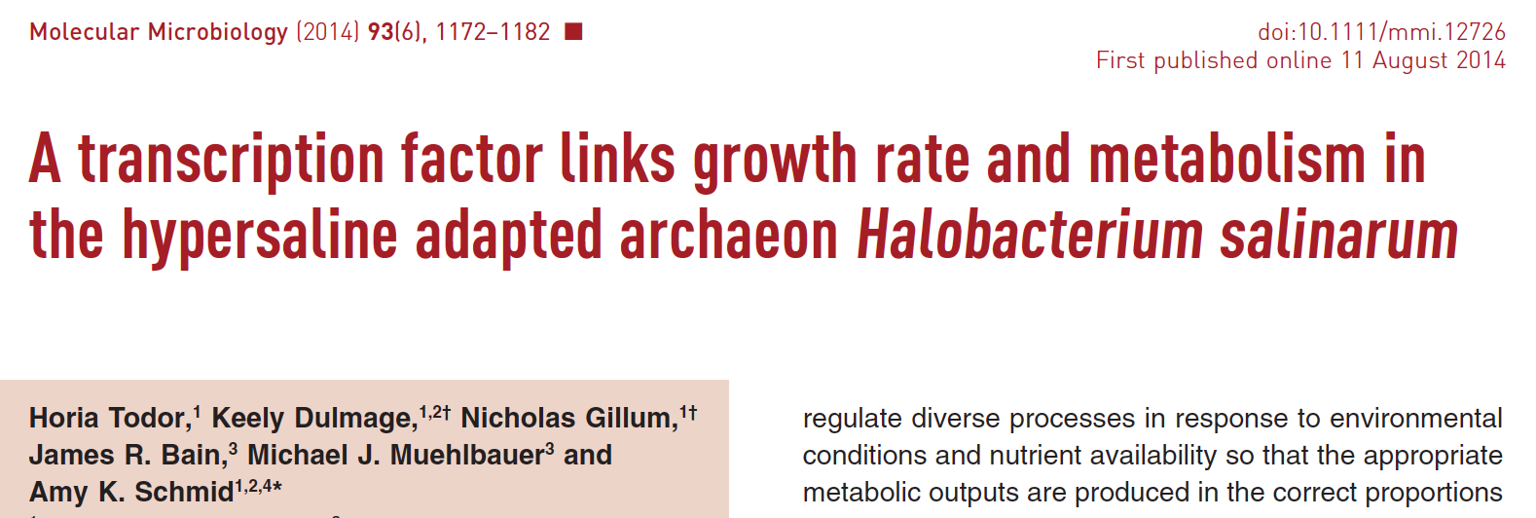
TrmB turns on gluconeogenic genes when there is no glucose around
but why?
Halobacterium salinarum doesn’t metabolize glucose!

Slide 18
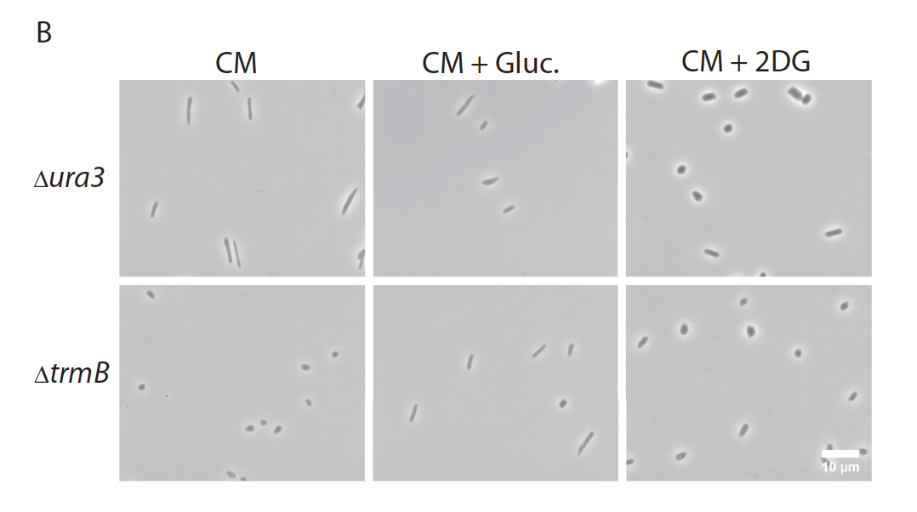
Glucose availability affects cell shape

Slide 19
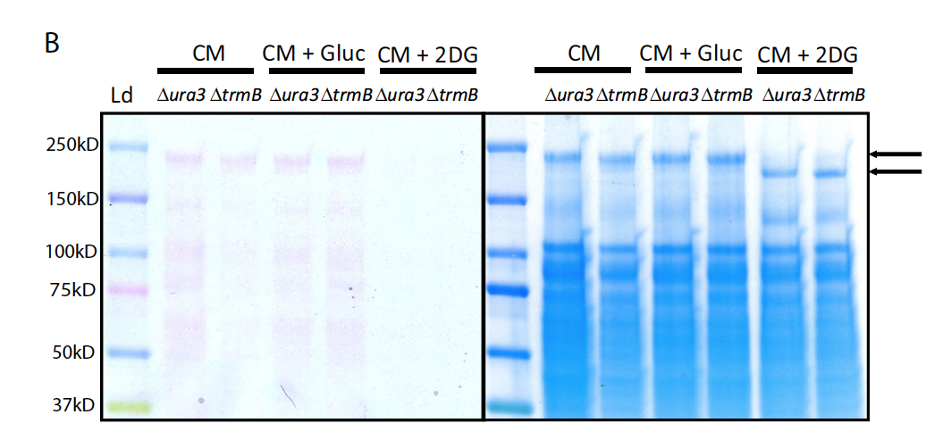
Glucose availability affects glycosylation of the cell wall

Slide 21
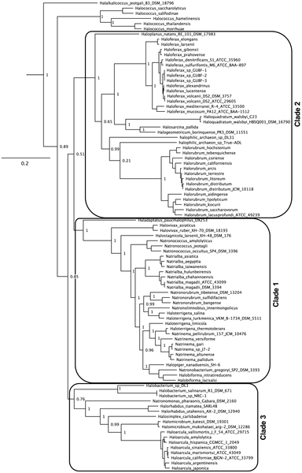
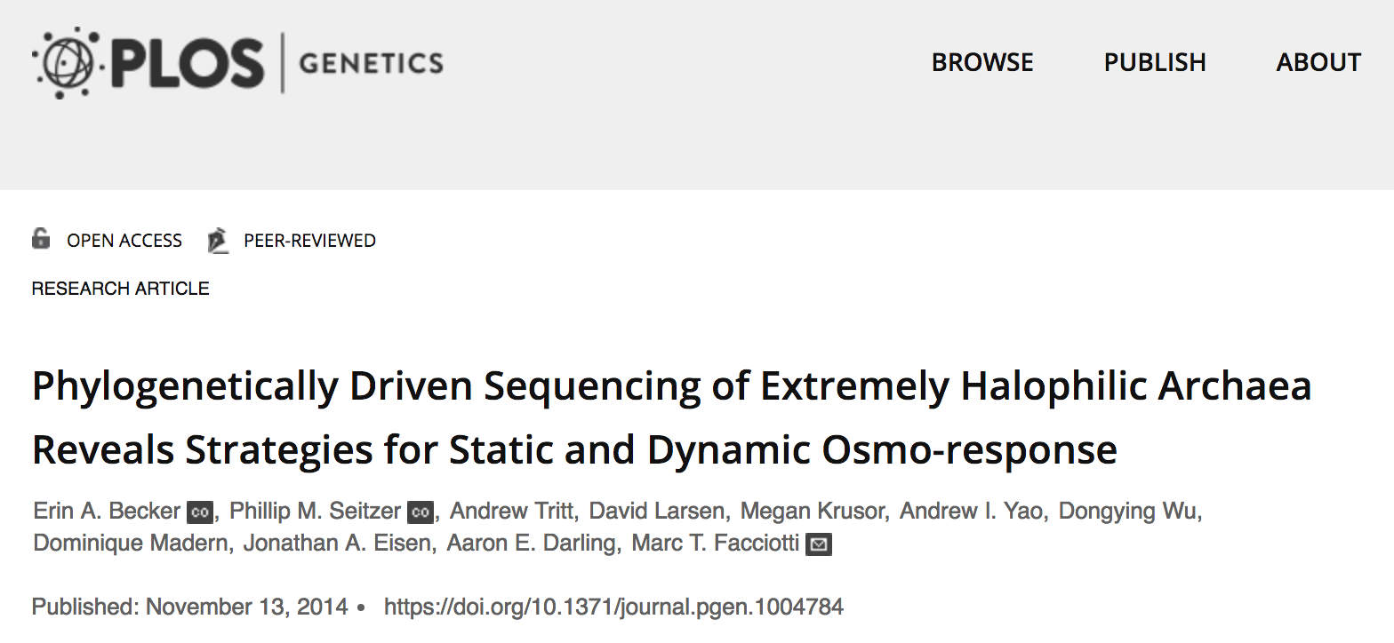

Slide 22




Haloferax volcanii
Halogeometricum borinquense
Halobacterium salinarum
Haloarcula hispanica

Slide 23
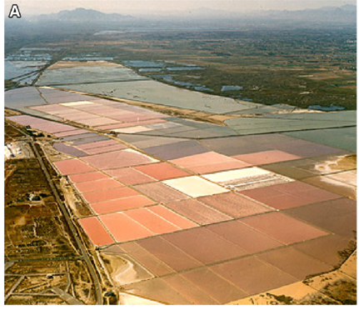
Haloferax volcanii
Halogeometricum borinquense
Santa Pola salterns at Alicante
Halobacterium salinarum
Ventosa et al, 2014. Extremophiles
Haloarcula hispanica

Slide 24
Sequence everything!

Slide 25
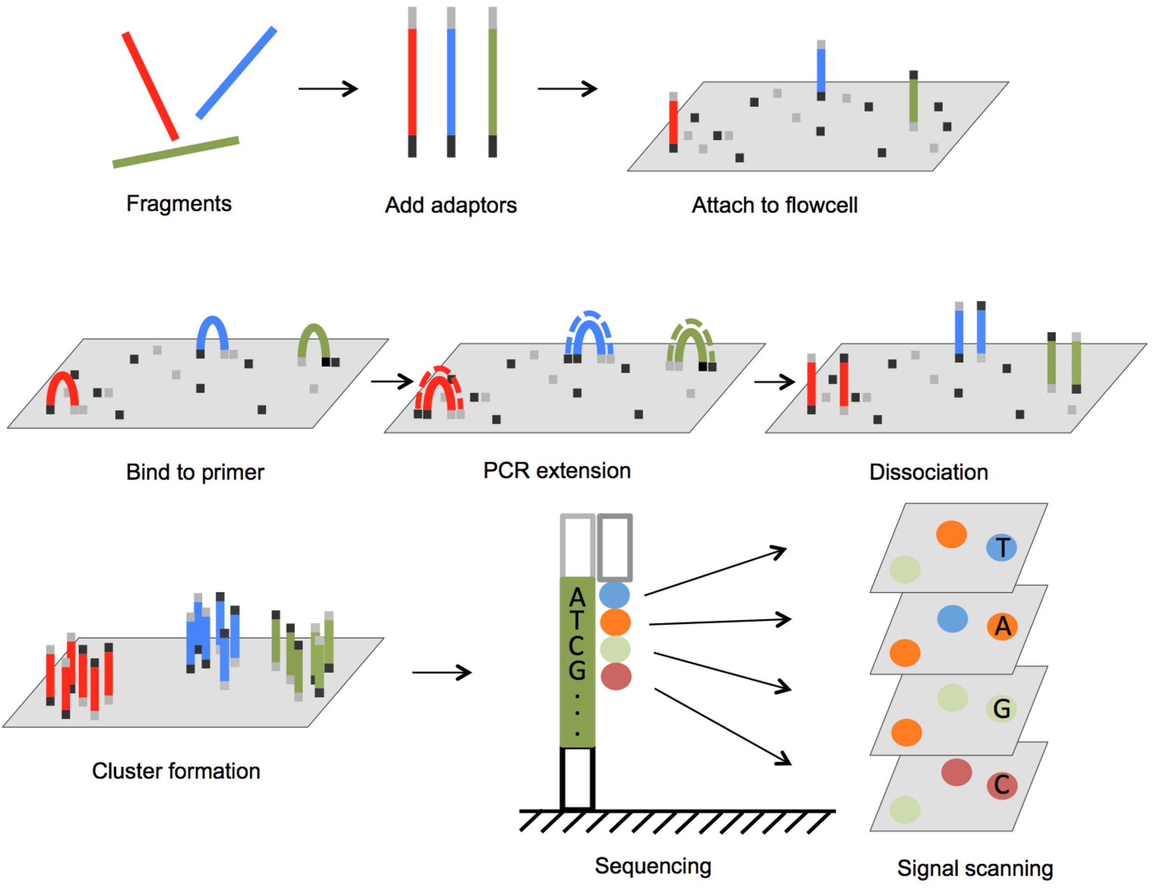

Slide 26
https://github.com/CindyDarnell/Mayaguez_NGS_workshop/wiki/

